Slide 1
LSTM CCG Parsing
Mike Lewis, Kenton Lee, Luke Zettlemoyer
Computer Science & Engineering
University of Washington
NAACL-HLT 2016

Slide 2
Combinatory Categorial Grammer
Compared to CFG, less binary rules(11) and more tags(425)
tags can be simple and complex.
such as N, NP, (S\NP)/NP
A/B = “give me a B to my right, then I’ll give you an A”
A\B = “give me a B to my left, then I’ll give you an A”
NP S\NP → S
Mary sleeps → Mary sleeps
(S\NP)/NP NP → S\NP
likes Mary → likes Mary

Slide 3
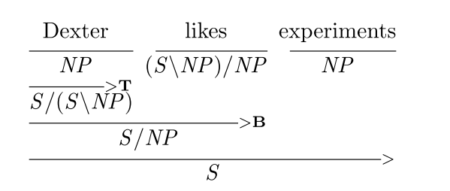
Combinatory Categorial Grammer
Application Combinators
X/Y Y ⇒ X
Composition Combinators
X/Y Y/Z ⇒ X/Z
Type-rasing Combinators
X ⇒ T/(T\X)

Slide 4
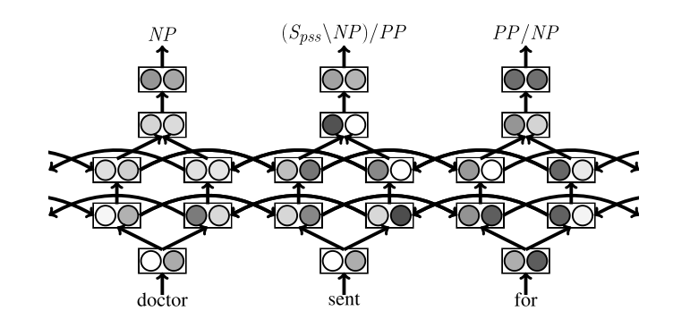
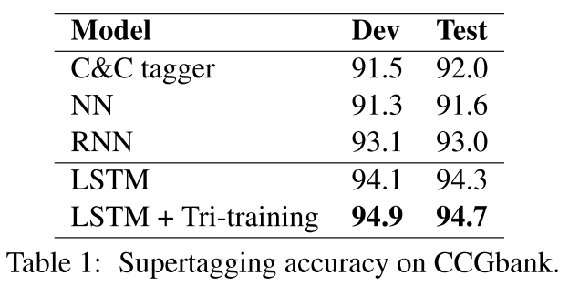
Model
LSTM Supertagging + A* CCG Parsing

Slide 5
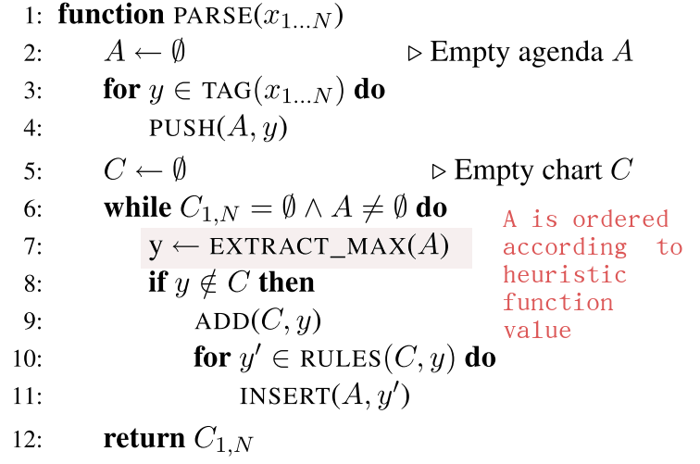
A* CCG Parsing
x1...N input word
y scored partial parses
TAG(x1...N) returns a set of scored
pre-terminals for every word
RULES(C, y) returns the set of scored partial parses that can be created by combining y with existing entries in C

Slide 6
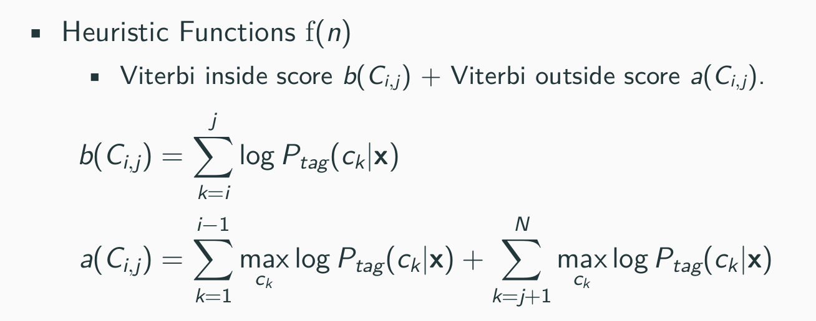
A* CCG Parsing

Slide 7
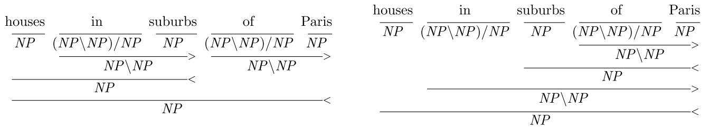
A* CCG Parsing
attach-low heuristic
add a small penalty of −εd at every binary rule instantiation
d is the absolute distance between the heads of the left and right children
ε is a small constant.

Slide 8
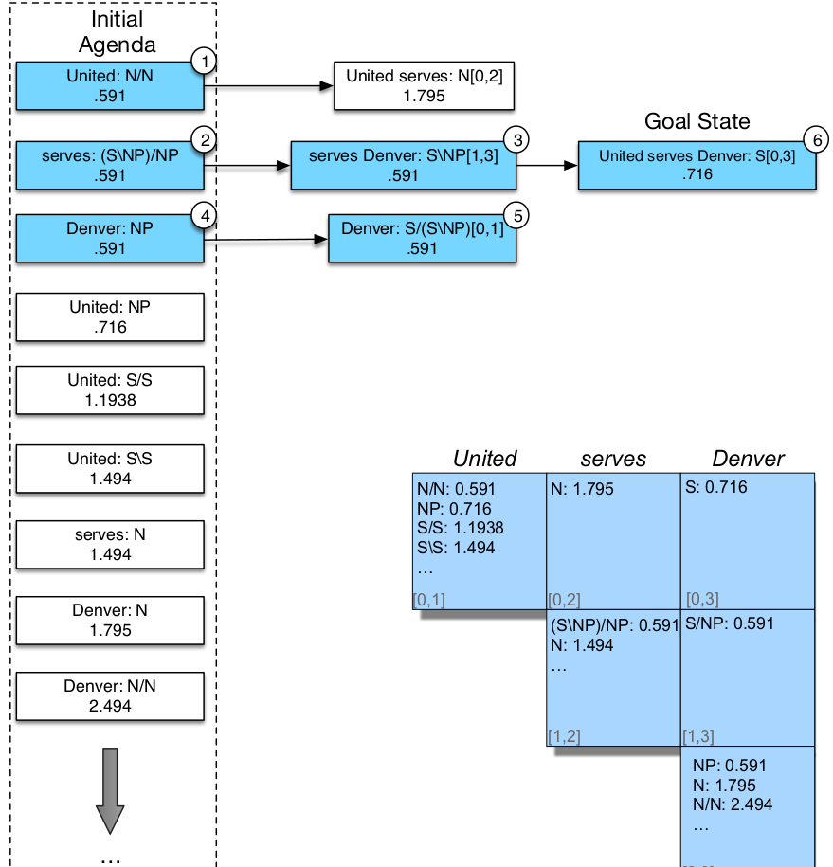

Slide 9
A* CCG Parsing
Guarantee for optimal
The first chart entry for a span is guaranteed to be optimal.
all other possible completions of the competing partial parses provably have lower scores, due to the outside score bounds.
No guarantee for efficiency
In the worst case the algorithm could fill the entire parse chart.
However, in practice it's fast.

Slide 10
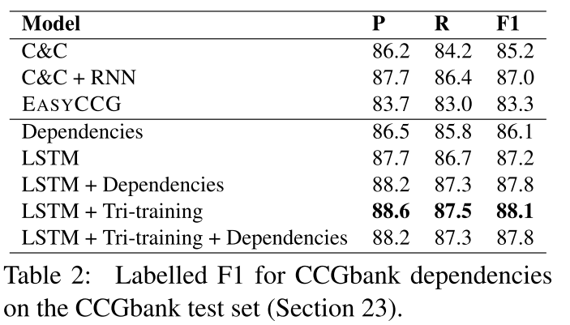
Parsing results on CCGBank

Slide 11
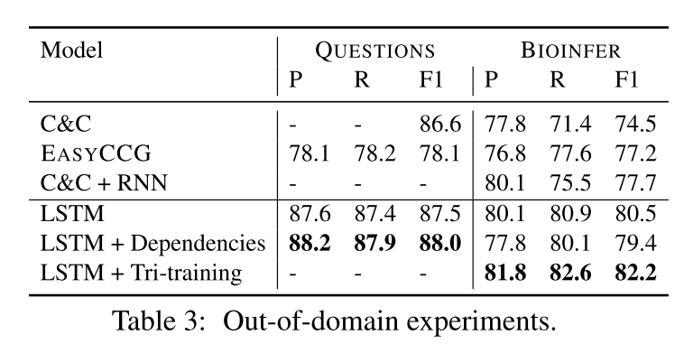
Out-of-domain results

Slide 12
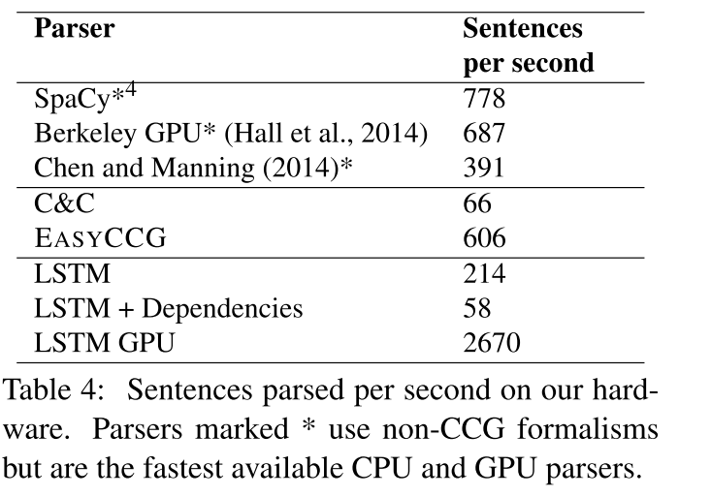
Parsing speed on CCGBank

Slide 13
Drawbacks?

